Slide 1




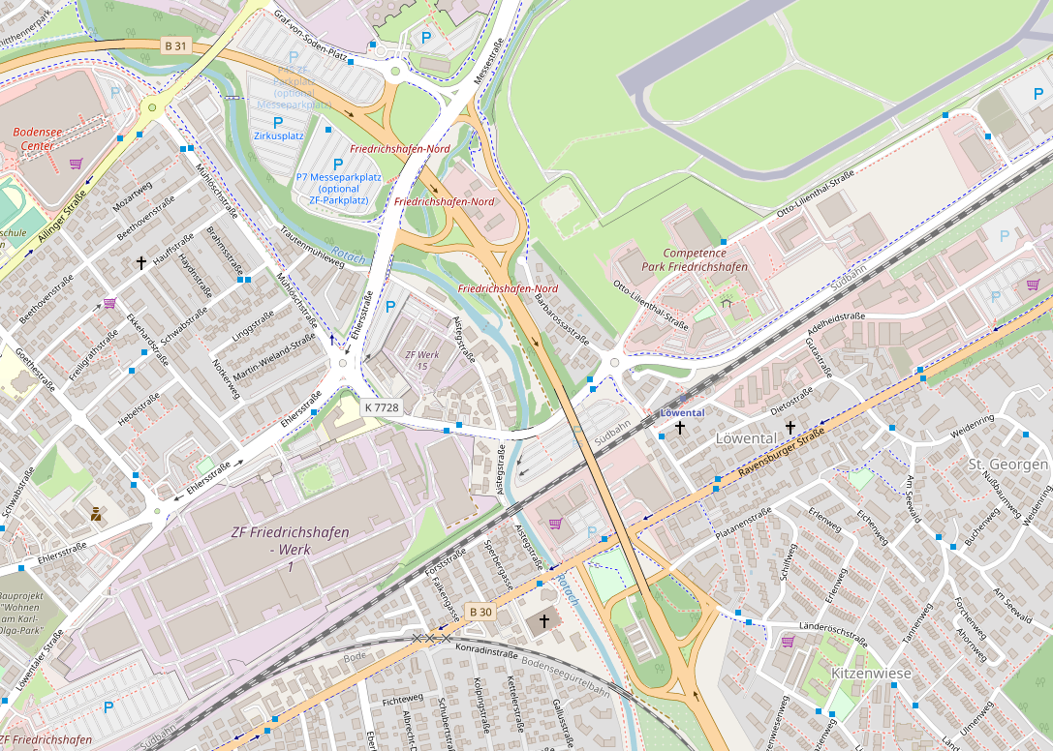
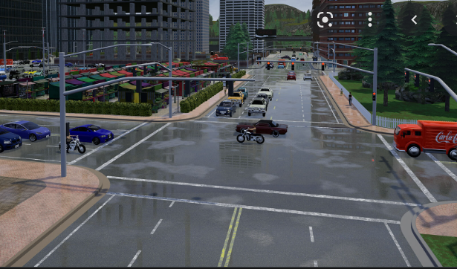
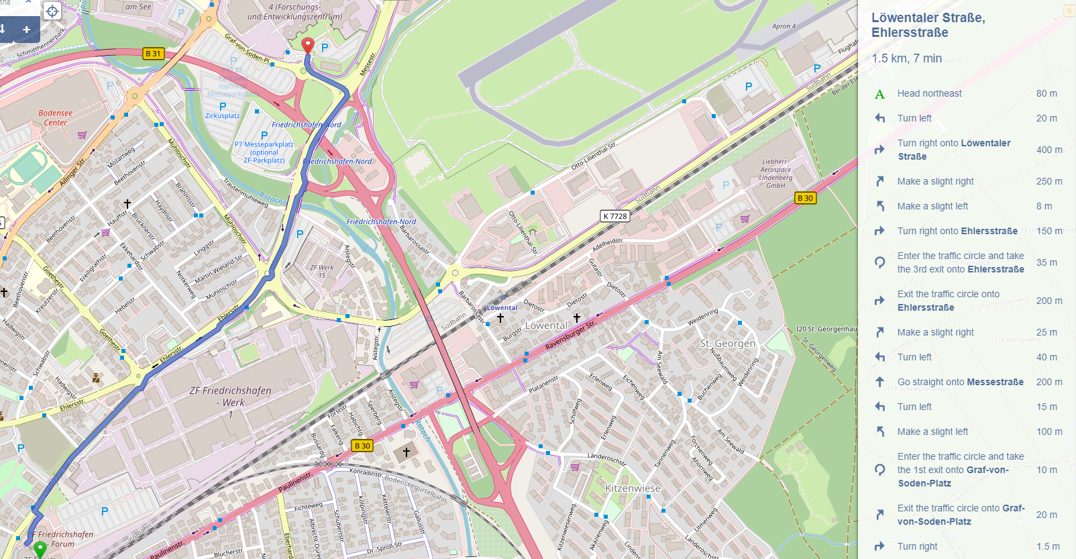
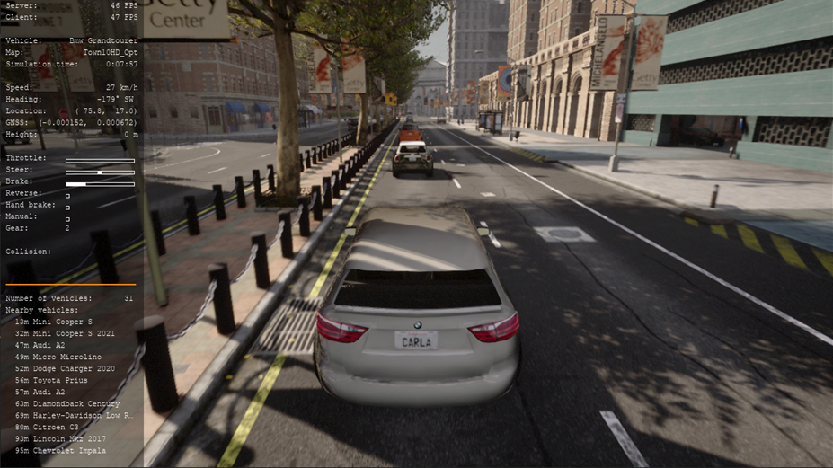
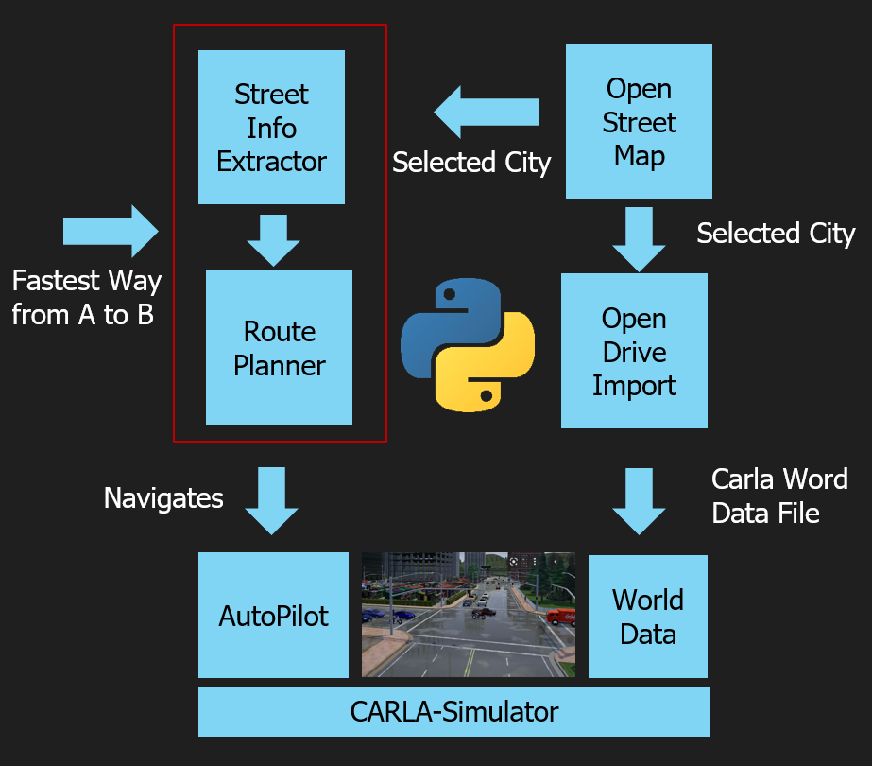


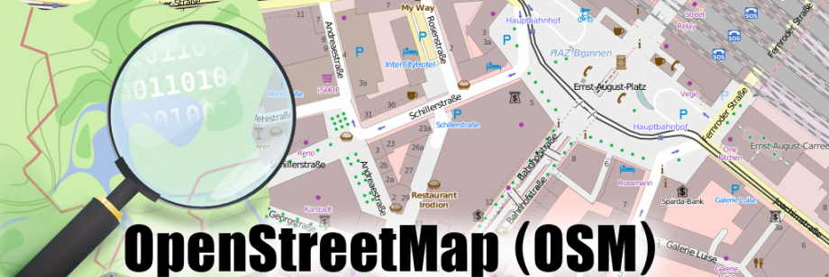

{hackathon}
Let‘s Play OSM and CARLA
BCX Challenge 4
Goal of the challenge:
Bring real world city and street data into the simulator’s virtual world
Implement best way of driving in this world from A to B and visualize it
Data source:
Map data
Example hacks:
Add a dashboard showing all the metrics
Create your own mobility as a service app
Test other auto-pilots or try to write your own
Route data
Example architecture:
Projects involved:

